Slide 1

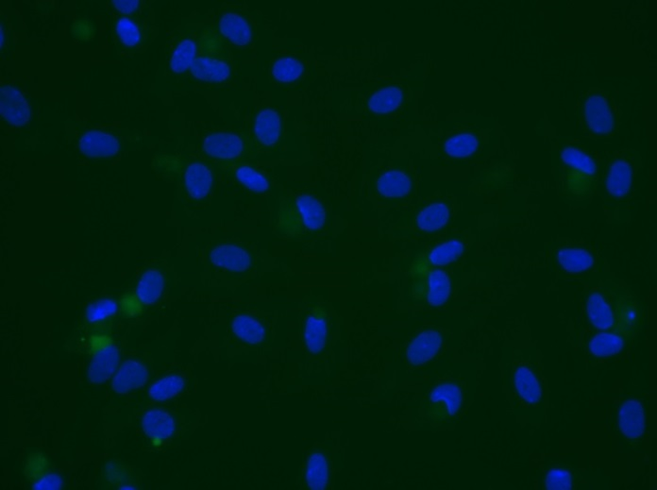
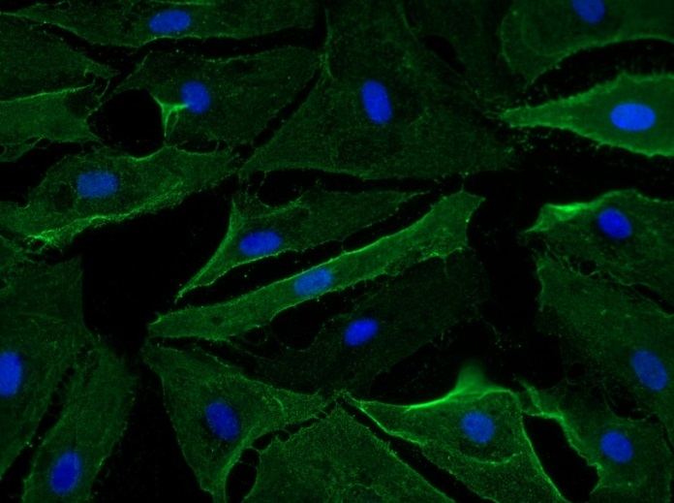
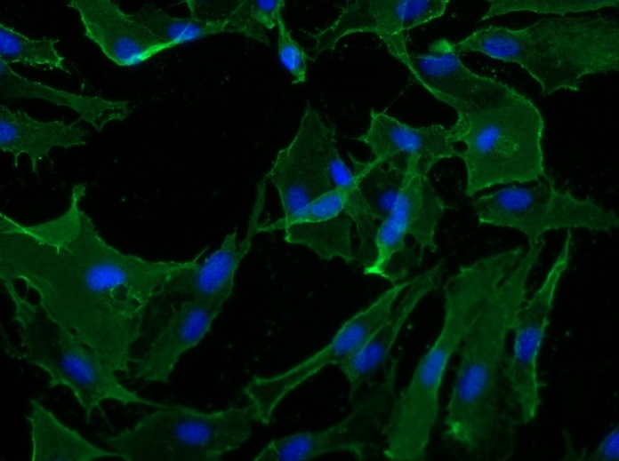
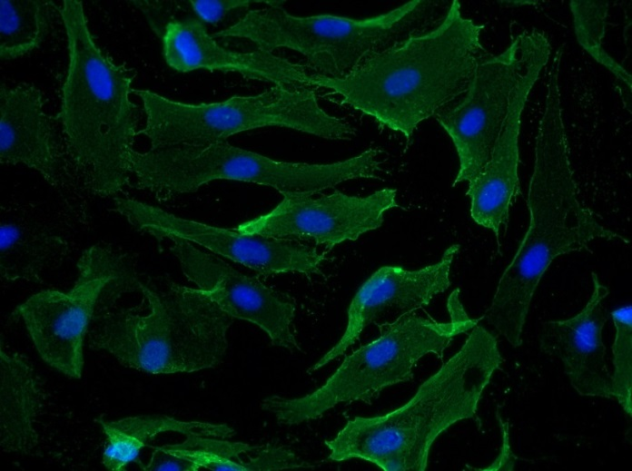
Reliatech GmbH
Mouse anti-human Podoplanin
(Cat# 101-M41)
Immunofluorescence staining of human Podoplanin in primary human lymphatic endothelial cells (HDLEC) using a monoclonal mouse anti-human Podoplanin (#101-M41) antibody.
As secondary antibody goat anti-mouse ALEXA Flour 488 (Dianova) was used 1:600. [IF_LEC1402-05]
.
Control: goat anti-mouse ALEXA Flour 488 (1:600)
0,5µg/ml
2µg/ml
5µg/ml
http://www.reliatech.de / orders@reliatech.de

